Slide 1


Vivian Chika-Ezeagu
12th February, 2023

Slide 2

Outline
Executive Summary
Introduction
Methodology
Results
Conclusion
Appendix

Slide 3
Executive Summary
The data for this project was collected from two sources: Space X API GET request and webscraping.
The data was processed and then wrangled to gain insight; exploratory data analysis was carried out through visualizations.
Interactive visual analysis was carried out through Folium and Plotly Dash.
Predictive analysis was performed using classification models. The models were evaluated on train and test data to determine accuracy levels.
It was determined that heavy payload masses have a negative effect on the success of a launch while the success rate increases with higher flight numbers and as the years go by could be determined.
All this information can be used to determine if Space X will reuse its first stage.

Slide 4
Introduction
SpaceX’s accomplishments include: Sending spacecraft to the International Space Station.
SpaceX advertises Falcon 9 rocket launches on its website with a cost of 62 million dollars; other providers cost upward of 165 million dollars each, much of the savings is because SpaceX can reuse the first stage.
The aim of the project is to determine the price of each launch. Instead of using rocket science to determine if the first stage will land successfully, a machine learning model is trained and used.
To determine the cost of a launch, the model is used to determine if the first stage will land. This information can be used if an alternate company wants to bid against SpaceX for a rocket launch.

Slide 5

Section 1

Slide 6
Methodology
Executive Summary
Data collection methodology:
Rocket launch data was requested from SpaceX API using a URL.
Falcon launch 9 records were extracted from Wikipedia through web scraping.
Some columns of data were filtered out and data wrangling by replacing with missing values with the mean values of the corresponding column.
Performed exploratory data analysis (EDA) using visualization and SQL
Performed interactive visual analytics using Folium and Plotly Dash
Performed predictive analysis using classification models

Slide 7
Data Collection
Data was collected through requests from the Space X API.
Data was also collected from wikipedia through a web scraping process.

Slide 8
Data Collection – SpaceX API
Import Libraries and Define Auxiliary Functions
Request rocket launch data from space X API using a URL
Using the GET request , request and parse the data
Data is stored in lists
Update the lists using auxilliary functions
Create a dictionary mapping the data with column names
Create a dataframe from the dictionary
Filter dataframe to include falcon 9 launches only
Replace missing values with the mean.
Dataframe is turned into .csv file.
Launch data is requested using a URL.
The data is parsed and stored in a list.
The data is stored in a dataframe, filtered, wrangled and stored in .csv format.
https://github.com/VivianEzeagu/ibm-projects/blob/main/jupyter-labs-spacex-data-collection-api%20(1).ipynb

Slide 9
Data Collection - Scraping
Import relevant libraries and create helper functions
Perform an HTTP GET method to request the Falcon9 Launch HTML page, as an HTTP response.
Create a object from the HTML response
Print the page title to verify if the object was created properly
Extract all column/variable names from the HTML table header
Create a data frame by parsing the launch HTML tables
Dataframe is saved in .csv format.
The rocket launch data is requested using a HTTP GET method.
The data is stored in a data frame.
The data is then saved in a .csv format.
https://github.com/VivianEzeagu/ibm-projects/blob/main/jupyter-labs-webscraping%20(1).ipynb

Slide 10
Data Wrangling
Import libraries and load the data
View the dataframe
Get the percentage of missing values for each attribute and datatypes
Get the number of launches from each site
Calculate the number and occurrence of element in categorical columns
Create dummy variables for categorical columns
Get the mean of the landing outcomes column to get the success rate
Export the data to to a CSV file.
The missing values were found and replaced by mean values.
The categorical variables where presented and replaced with dummy variables.
Determination of success rate of landing outcome.
https://github.com/VivianEzeagu/ibm-projects/blob/main/IBM-DS0321EN-SkillsNetwork_labs_module_1_L3_labs-jupyter-spacex-data_wrangling_jupyterlite.jupyterlite%20(1).ipynb

Slide 11
EDA with Data Visualization
Various scatterplots were created to aid data visualization.
The scatterplots were created in order to view the relationships between variables and determine the extent of the effect on outcome of the launch.
The Plot of the flight number vs payload mass showed that the first stage is more likely to succeed with a higher flight number and the less likely to succeed with higher payload mass.
A bar chart was created to visualize the success rate of each orbit.
Based on the information gotten from the data visualization, a new table was created with the variable that can help predict the outcome of the first stage.
https://github.com/VivianEzeagu/ibm-projects/blob/main/IBM-DS0321EN-SkillsNetwork_labs_module_2_jupyter-labs-eda-dataviz.ipynb.jupyterlite.ipynb

Slide 12
EDA with SQL
The dataset was downloaded and loaded into the database table.
A connection to the database was established.
Exploratory analysis was carried out on the data after important libraries were imported to gain insight on the data.
https://github.com/VivianEzeagu/ibm-projects/blob/main/login.html

Slide 13
Build an Interactive Map with Folium
Launch success may also depend on the location and proximities of a launch site, i.e., the initial position of rocket trajectories. Finding an optimal location for building a launch site certainly involves many factors ,we could discover some of the factors by analyzing the existing launch site locations.
Markers were where created to visualize each of the launch sites on the map. The circle was created to highlight the site locaions and aid visualization.
A marker color object was also added to enhance the map by adding the launch outcomes for each site represented by different colors, and see which sites have high success rates.
A mouse pointer was added to easily get the longitude and latitude of the launch sites.
A line was added to visualize the distance between launch sites and significant structures like railways.
https://github.com/VivianEzeagu/ibm-projects/blob/main/dashboard%20api.ipynb

Slide 14
Build a Dashboard with Plotly Dash
A dropdown list was added to enable Launch Site selection.
A pie chart was added to show the total successful launches count for all sites.
Added a scatter chart to show the correlation between payload masses and launch success.
https://github.com/VivianEzeagu/ibm-projects/blob/main/dashboard.ipynb

Slide 15
Predictive Analysis (Classification)
An object was created for each model then a GridSearchCV object was also created.
The object was fitted to find the best parameters from the dictionary parameters.
An output of the GridSearchCV object for each model.
The best parameters were displayed and the accuracy on the validation data was calculated.
https://github.com/VivianEzeagu/ibm-projects/blob/main/IBM-DS0321EN-SkillsNetwork_labs_module_4_SpaceX_Machine_Learning_Prediction_Part_5.jupyterlite%20(1).ipynb
Standardize the data
Perform a train-test split
Build several machine learning models
Measure the accuracy of each model for train and test data.
Create a confusion matrix

Slide 16
Results
Exploratory data analysis results
Interactive analytics demo in screenshots
Predictive analysis results

Slide 17

Section 2

Slide 18
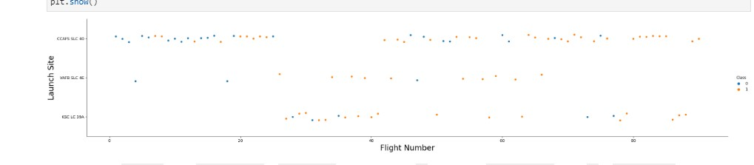
Flight Number vs. Launch Site
This scatter plot shows that as the flight number increases the first stage is more likely to be successful.
KSC LC 39A had more successful launches than unsuccessful.
CCAFS SLC 40 had more unsuccessful launches at the initial flight attempts, the launches became more successful with increasing flight number.
VAFB SLC 46 had more successful launches than unsuccessful.

Slide 19
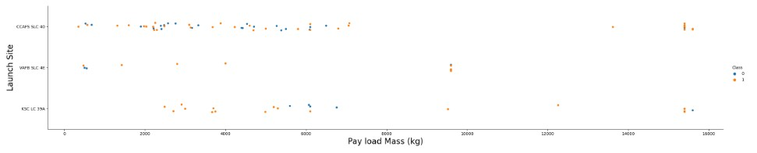
Payload vs. Launch Site
VAFB SLC 46 had fewer lauches than the other sites but had more successful launches.
KSC LC 39A had more launches with a wide range of payload mass but had more successful launches.
CCAFS SLC 40 had most of the launches with lower pay load mass but has a nearly fair number of successful and unsuccessful launches.
More Launches generally took place with lighter payload mass.

Slide 20
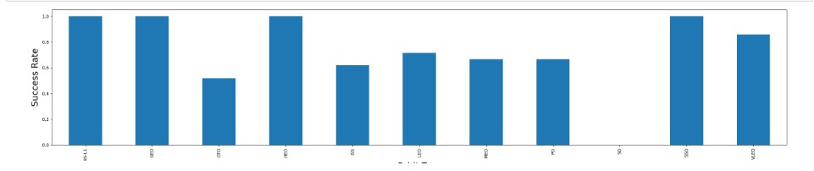
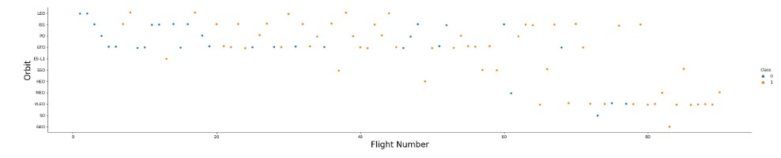
Success Rate vs. Orbit Type
The success rate of LEO, PO are moderate whereas VLEO success rate is a little higher.
ES –L1, HEO, SSO, GEO had very high success rates.

Slide 21
Flight Number vs. Orbit Type
The success rate of LEO, PO are mostly related to flight number whereas GTO success rate has no correlation with the flight number.
ES –L1, HEO, SSO, GEO had very few launch attempts with later flights which explains their success rate.

Slide 22
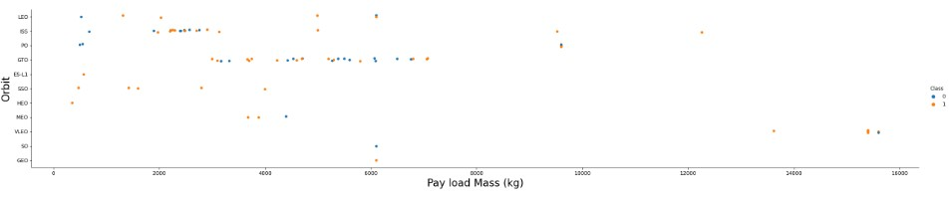
Payload vs. Orbit Type
With heavy payloads the successful landing rate are more for Polar, LEO and ISS.
However for GTO we cannot distinguish this well as both positive landing rate and negative landing(unsuccessful mission) are both there here.
ES L1, SSO, HEO have launches only with light payload mass and they were all successful.

Slide 23
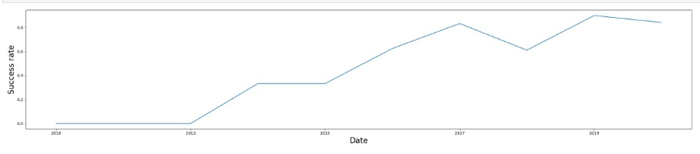
Launch Success Yearly Trend
The success rate was constant between 2010 and 2013.
From 2013, the success rate had a continual increase till 2015, where there’s a slight decrease, there’s a continued increase after till 2017 ,where there’s a decrease then another increase from 2018 till 2019 then a decrease past 2019.

Slide 24
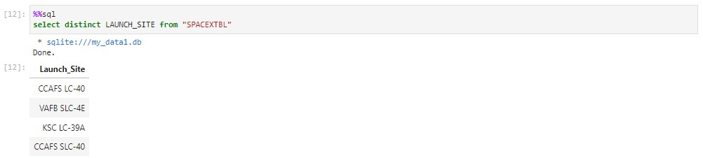
All Launch Site Names
There are four unique launch sites:
CCAFS LC-40
VAFB SLC -4E
KSC LC -39A
CCAFS SLC -40

Slide 25
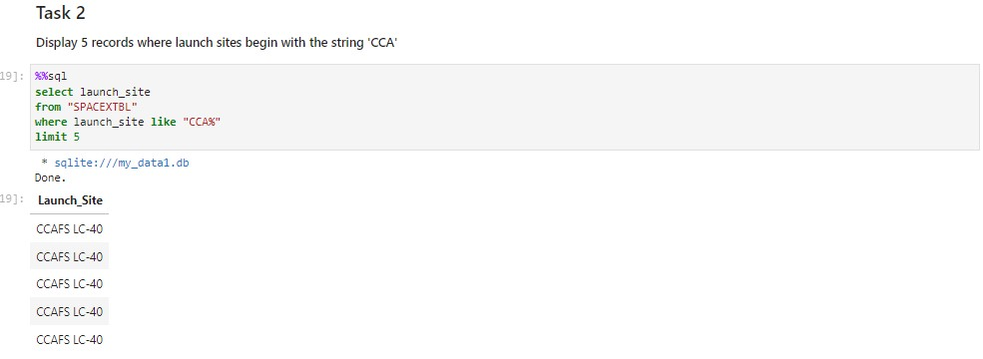
Launch Site Names Begin with 'CCA'
The above are five launch records that have launch site names beginning with “CCA”

Slide 26
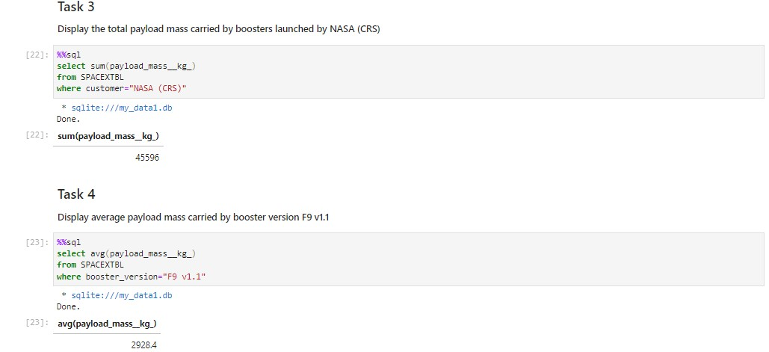
Total Payload Mass
The above shows the total payload mass carried by all the boosters launched by NASA(CRS).

Slide 27
Average Payload Mass by F9 v1.1
The average payload mass carried by booster F9 v1.1 is 2928.4kg.

Slide 28
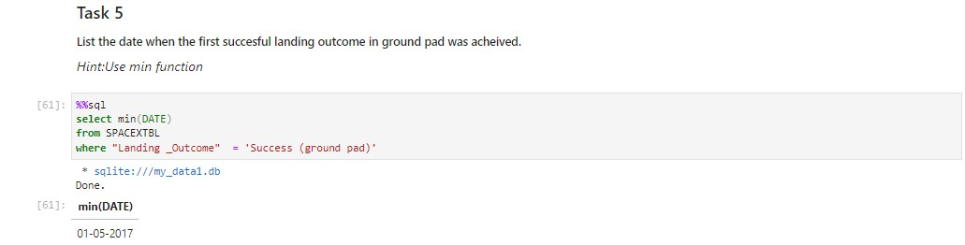
First Successful Ground Landing Date
The above query shows the first successful landing that took place on a ground pad, which was on the 1st of May, 2017.

Slide 29
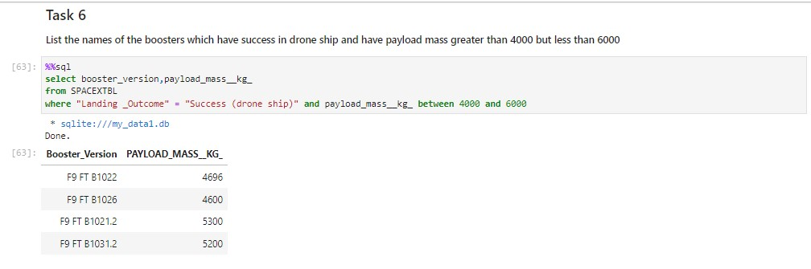
Successful Drone Ship Landing with Payload between 4000 and 6000
The above shows boosters which has landing success in drone ship with a payload mass between 4000kg and 6000kg

Slide 30
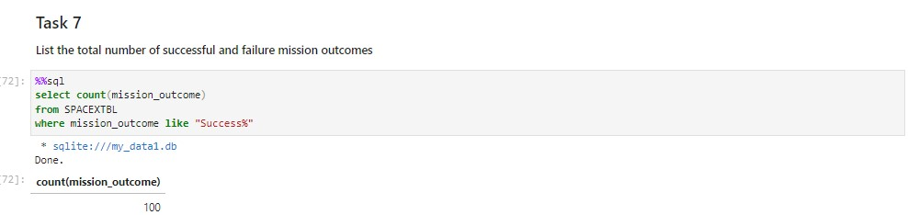
Total Number of Successful and Failure Mission Outcomes
The above shows the total number of successful and failure mission outcomes.

Slide 31
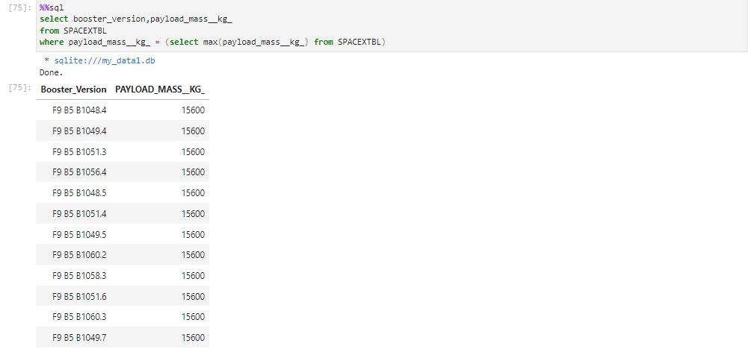
Boosters Carried Maximum Payload
The boosters that have carried maximum payload mass are shown in the table above.

Slide 32
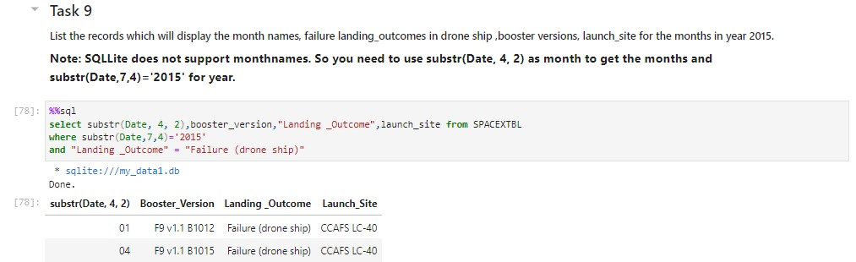
2015 Launch Records
The result shows the months and other records in 2015 that landing failed in the drone ship.

Slide 33
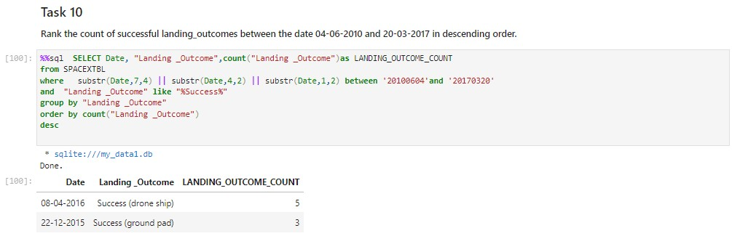
Rank Landing Outcomes Between 2010-06-04 and 2017-03-20
The number of successful landing outcomes between 4th of June,2010 and 20th of March, 2017 are shown in descending order.

Slide 34

Section 3

Slide 35
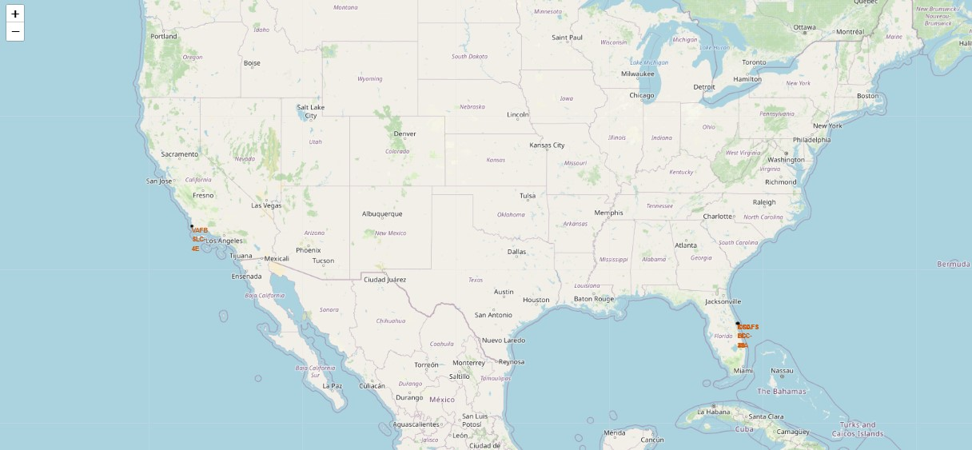
Global map displaying launch site locations
This map shows the locations of all the launch sites on a global map.
The launch sites are all at close proximity to the coastline which is safe area because it is far away from cities, highroads and other areas where it could be harmful to humans.

Slide 36
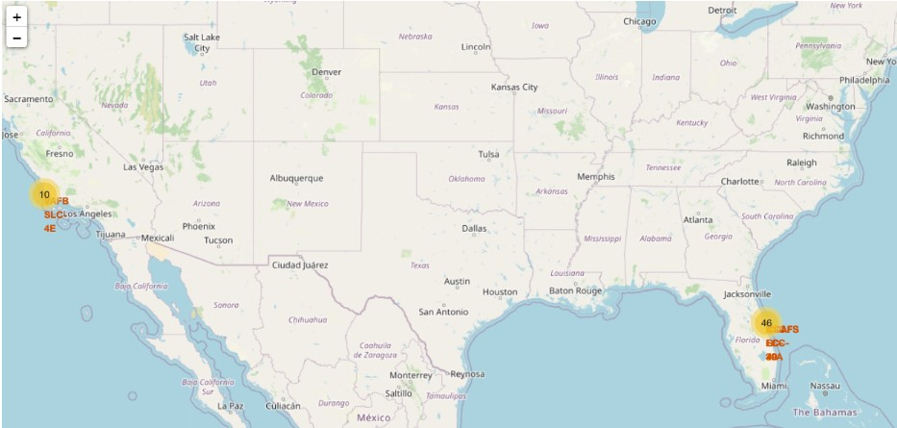
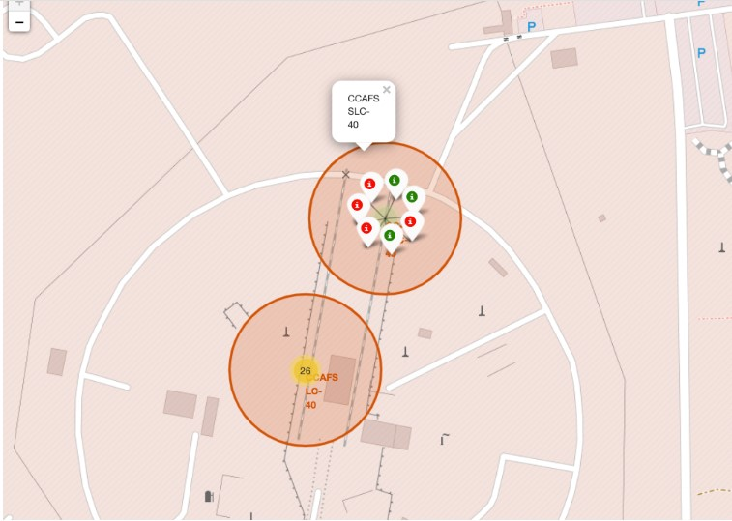
Folium map displaying the launch outcomes of the launch sites
The map shows the color-labeled launch outcomes for each site, where green represents successful launch outcomes and red represents the unsuccessful outcomes.

Slide 37
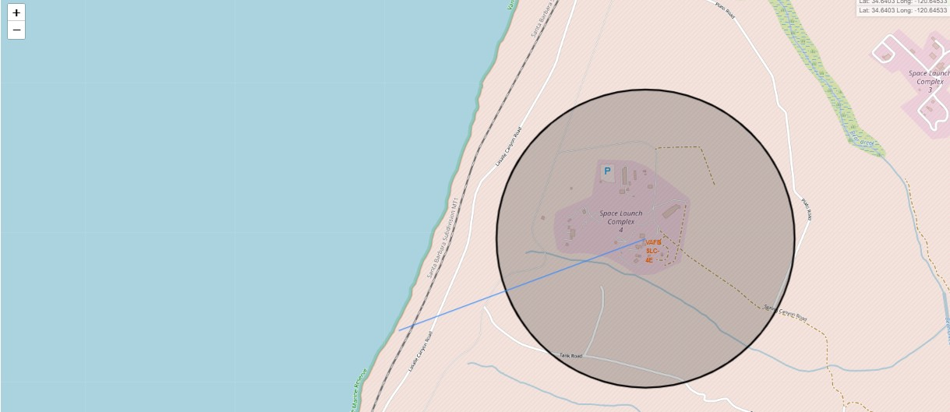
Folium map displaying the distance of VFAB SLC-4E from the coastline
This shows the distance of VFAB SLC-4E from the coastline.

Slide 38

Section 4

Slide 39
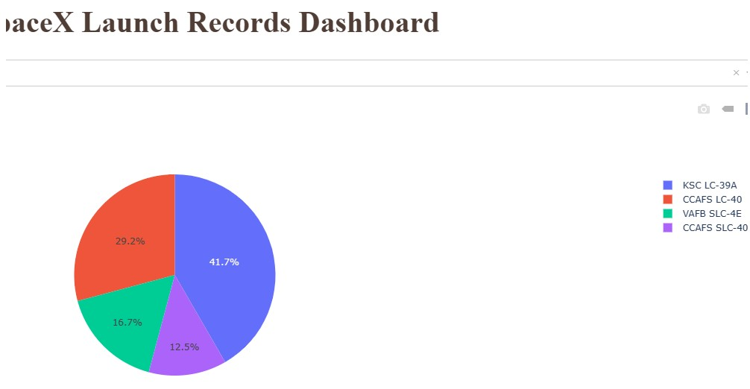
Pie chart of success count for all launch sites
The KSC LC 39A has the highest percentage of successful landings.
The CCAFS SLC -40 has the least successful launches.
http://localhost:8090/

Slide 40
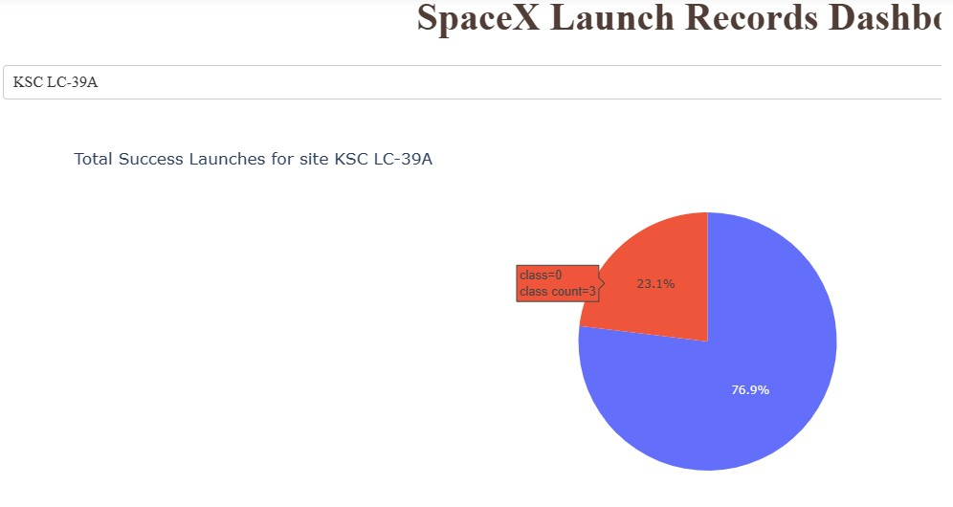
Pie chart of the KSC LC -39A
The KSC LC -39A launch site has the most successful launches overall with 76.9% of the launches being successful.

Slide 41
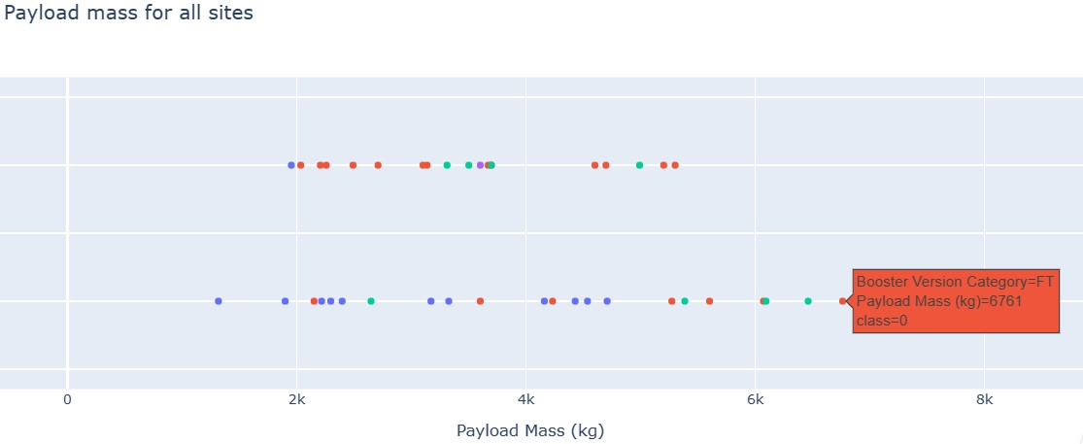
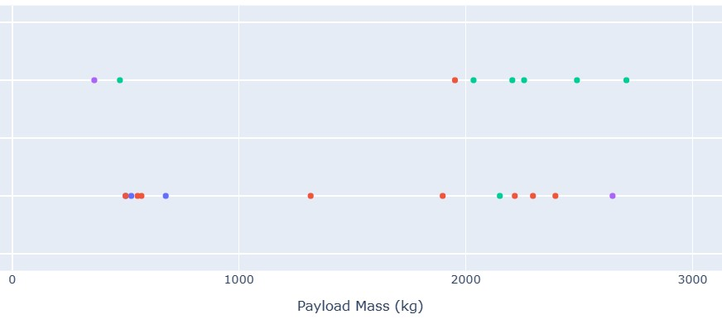
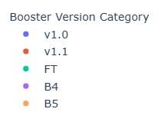
Scatter plots of Payload vs. Launch Outcome
The scatter plots show the success rate of the booster versions per payload mass.
Booster v1.1 has high success rate with payload mass between 2000kg and 6000kg while v1.0 experiences the opposite.
Booster FT has more successes within 500kg-3000kg payload range.

Slide 42

Section 5

Slide 43
Classification Accuracy
The decision tree has the highest accuracy with an accuracy of 0.94.

Slide 44
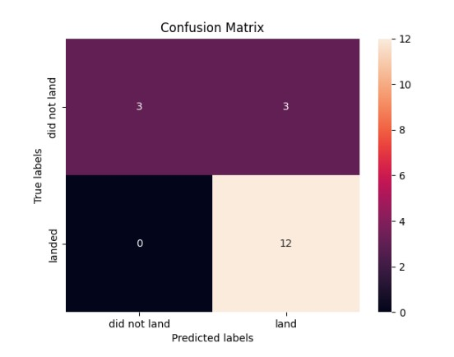
Confusion Matrix
The best performing model is the decision tree model.
The confusion matrix shows that 12 successful launches were correctly predicted and 3 incorrect, 3 unsuccessful launches were correctly predicted.

Slide 45
Conclusions
This data set revealed interesting insights; the payload can determine the landing outcome of the launch depending on the booster version that carries it.
As the flight number increases, the success rate increases.
The booster v1.1 has a lot of successful outcomes across wide payload range.
The KSC LC -39A has the most successful launches, which could be influenced by orbit, boosters and payload mass.
The optimal machine learning model to be used is the decision tree model because of the high accuracy level of 0.94.
These variables can be used to determine if the first stage will return which will enable the determination of the price of the launch.

Slide 46
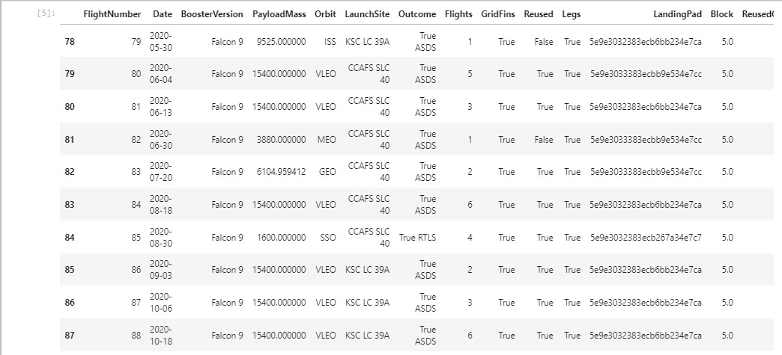
Appendix
Dataset worked on is shown above.

Slide 47


